Slide 1
Group 18

Slide 2
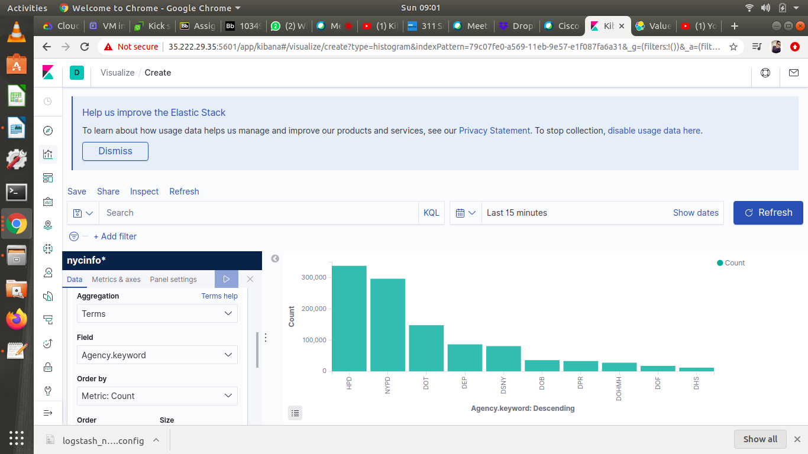
Rajharini Krishnasamy

Slide 3
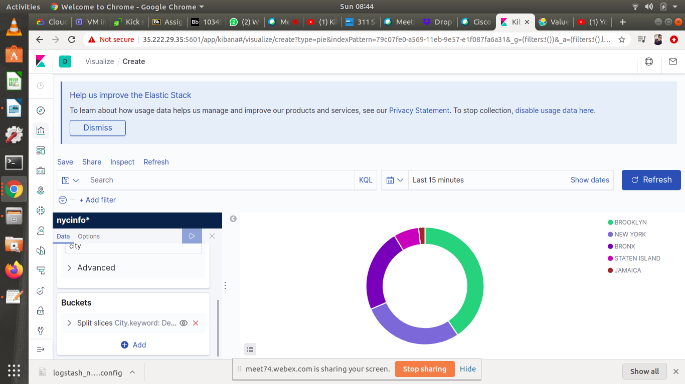

Slide 4
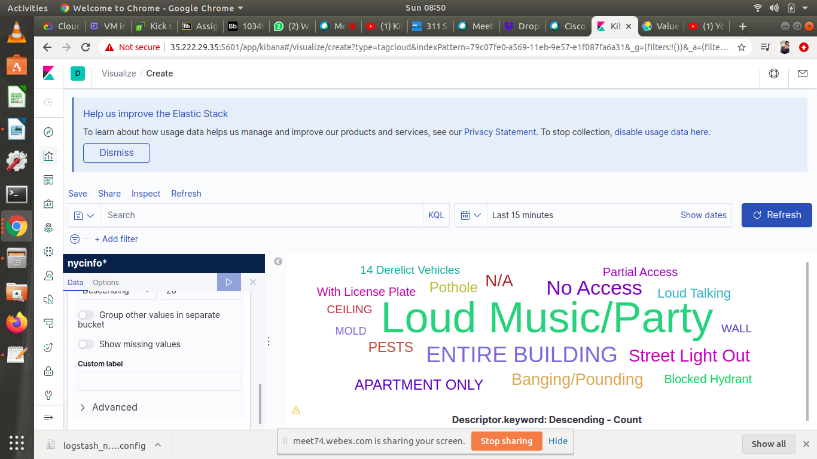
Keerthy Raaj Shanmugam

Slide 5
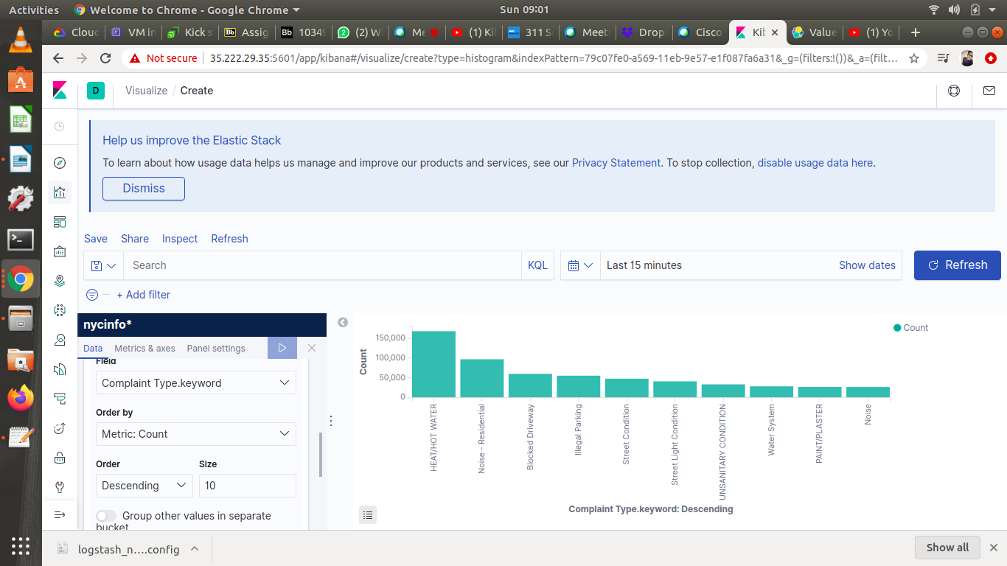

Slide 6
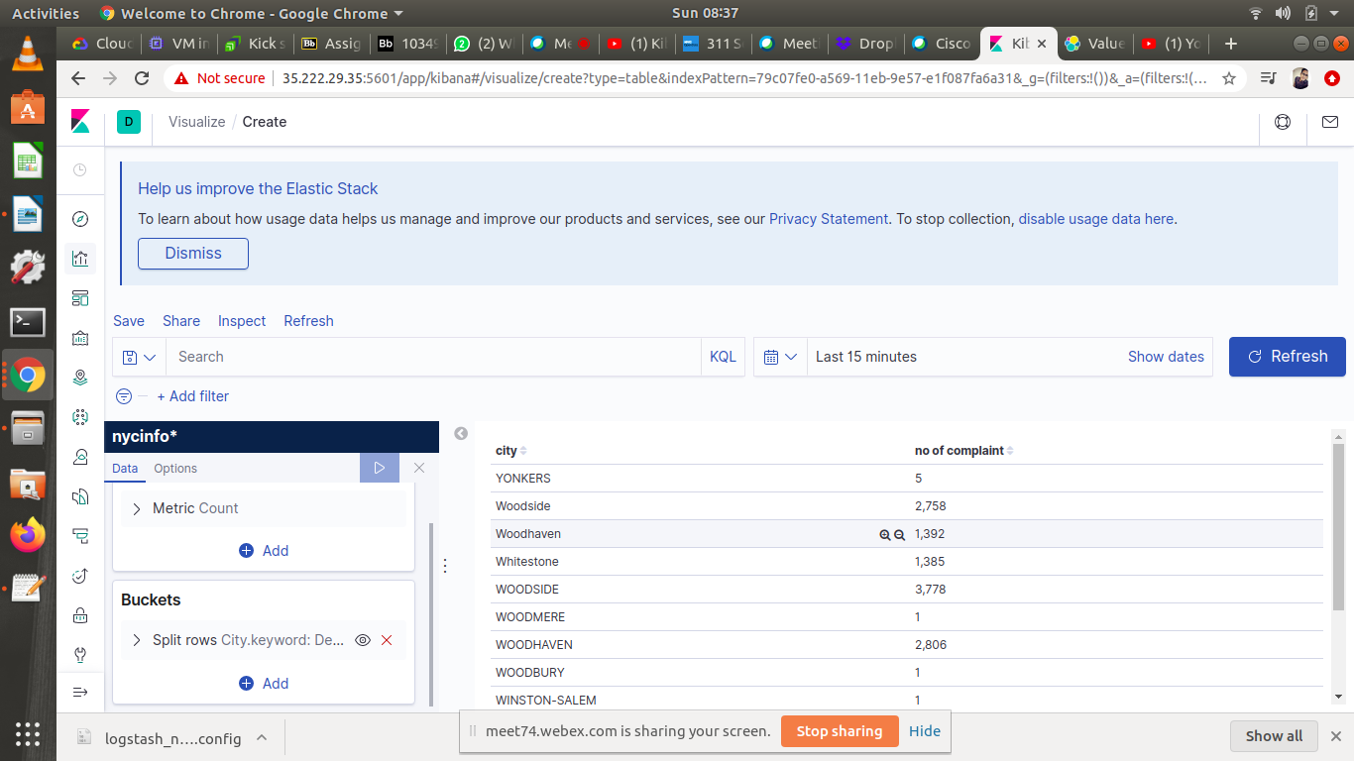
Shaochen DU

Slide 7
